Slide 1

Alpha Anywhere Q&A
March 9, 2022

Slide 2


Slide 3

Register at www.alphasoftware.com/devcon2022

Slide 4

Cordova CLI
Introduction to building Android apps with Cordova CLI

Slide 5
What is Cordova CLI?
A Command Line Interface (CLI) for building mobile applications using the Apache Cordova framework.
Apache Cordova is a framework for building native mobile applications for Android and iOS.
Apps built using HTML, CSS, and JavaScript
Build your app once. Deploy to multiple platforms.

Slide 6
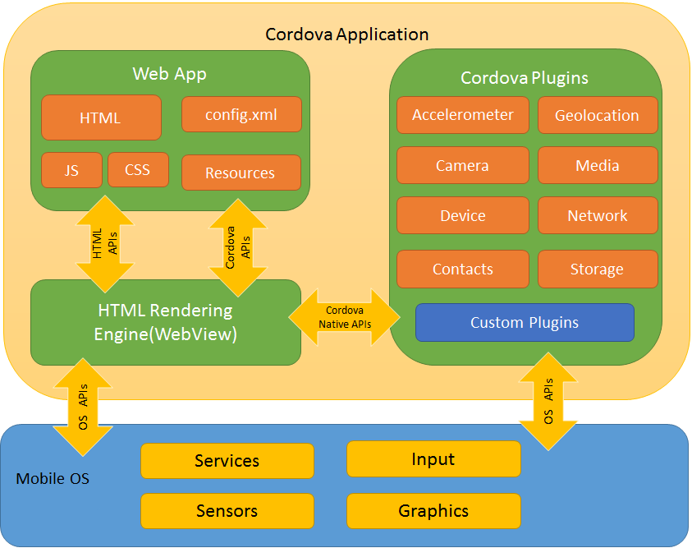

Apache Cordova
Alpha Anywhere

Slide 7
Required Tools (Windows)
Java Development Kit (JDK) 8.0
Gradle
Git
Node.js
Cordova 10.0.0
npm install -g cordova@10.0.0
Android Studio

Slide 8
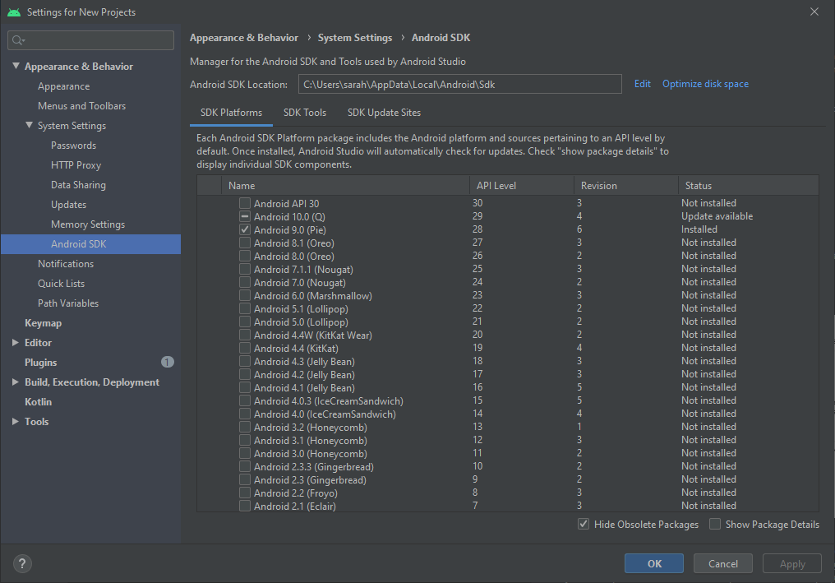
Install Android SDK(s) and Build Tools
SDK Platforms
Android API 30

Slide 9
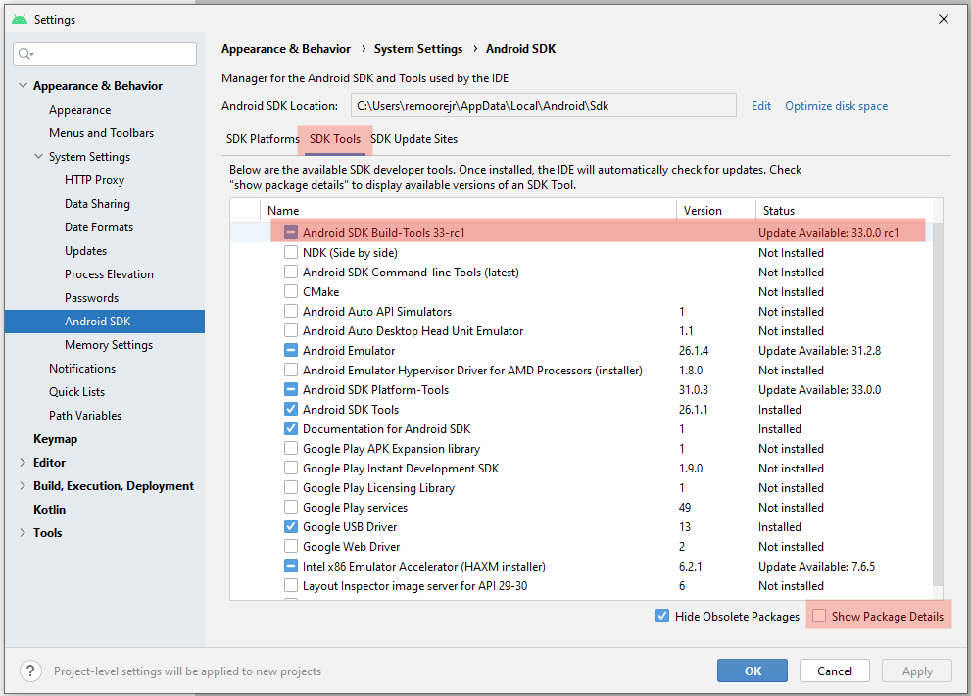
Install Android SDK(s) and Build Tools
SDK Tools
SDK Build Tools version 30.0.3

Slide 10
Configuring Windows Environment
Create System Variables
JAVA_HOME - Location of the JDK installation
ANDROID_SDK_ROOT - Location of the Android SDK installation
Update your System PATH
Add JDK bin, Android platform-tools, and Gradle bin

Slide 11
Required Tools (Mac OSX)
Xcode
iOS-deploy
Cordova CLI recommends using Homebrew
brew install ios-deploy
Can also install using npm
sudo npm install -g ios-deploy@latest --force
Node.js
Cordova
npm install -g cordova@10.0.0

Slide 12
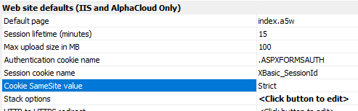
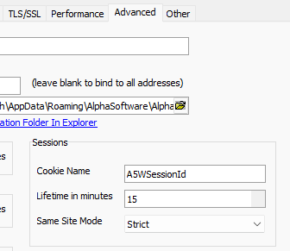
Configure the Server SameSite Value
Set Server SameSite value to Unset
Alpha Cloud, IIS
Web Project Properties > Web site defaults > Cookie SameSite value
Classic Server
Server Settings > Advanced > Same Site Mode

Slide 13
Publish your App to the Server
Required if your app makes any callbacks to the server
Get the Ajax Callback URL

Slide 14

Create a Cordova Project
Set App Build Target: CLI
Configure remaining options for your application

Slide 15

Save Cordova Project
Alpha Anywhere will add any plugins it detects as required
Only applies to Action Javascript, Alpha Anywhere JavaScript framework
This is not guaranteed to add all of them. E.g. will not add your plugins.
Add additional Plugins needed by your app

Slide 16

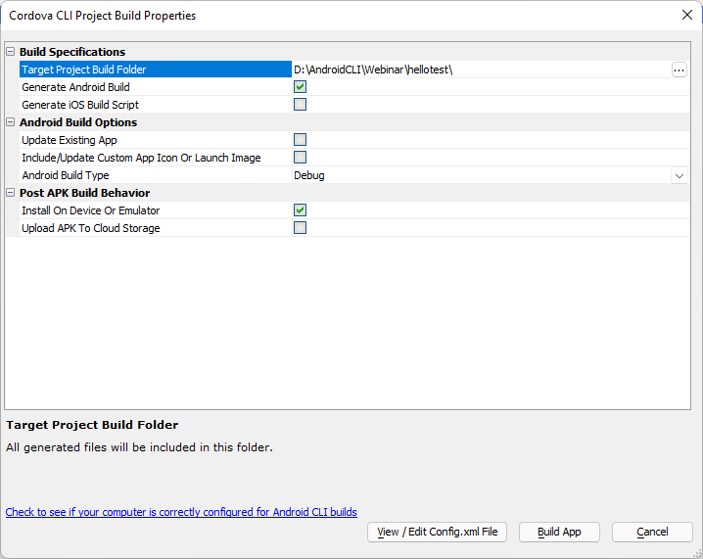
Save and Build for Cordova

Slide 17

Emulators
Virtual Devices
Need to install Emulator from SDK Tools
Add and configure a Virtual Device
Wide range of device options available
Can launch app from Alpha Anywhere in the Emulator

Slide 18

Demo

